Slide 1
3D MESH COMPRESSION
A Brief History of
ORAL, M. ELMAS, A.A.

Slide 2
Outline
3D Models and Polygonal Mesh Usage Areas
Polygonal Mesh Basics
Representation and Storage
Compression
Single Rate Mesh Compression
Geometry Compression
Connectivity Compression
Pioneering Algorithms
Performance Results
Conclusion
Algorithms
Geometry Compression
Topological Surgery
EdgeBreaker
Triangle Mesh Compression

Slide 3
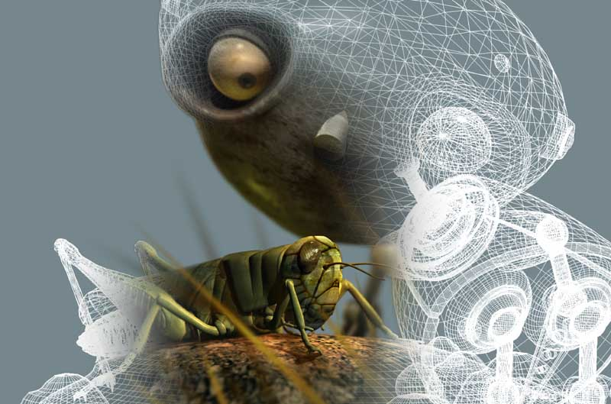
Movies
“Rustboy” animated short by Brian Taylor

Slide 4
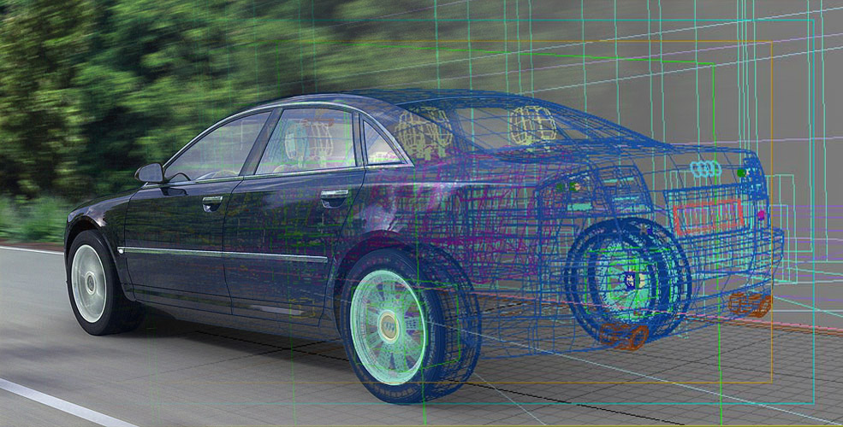
Engineering
“Audi A8” created by Roland Wolf

Slide 5
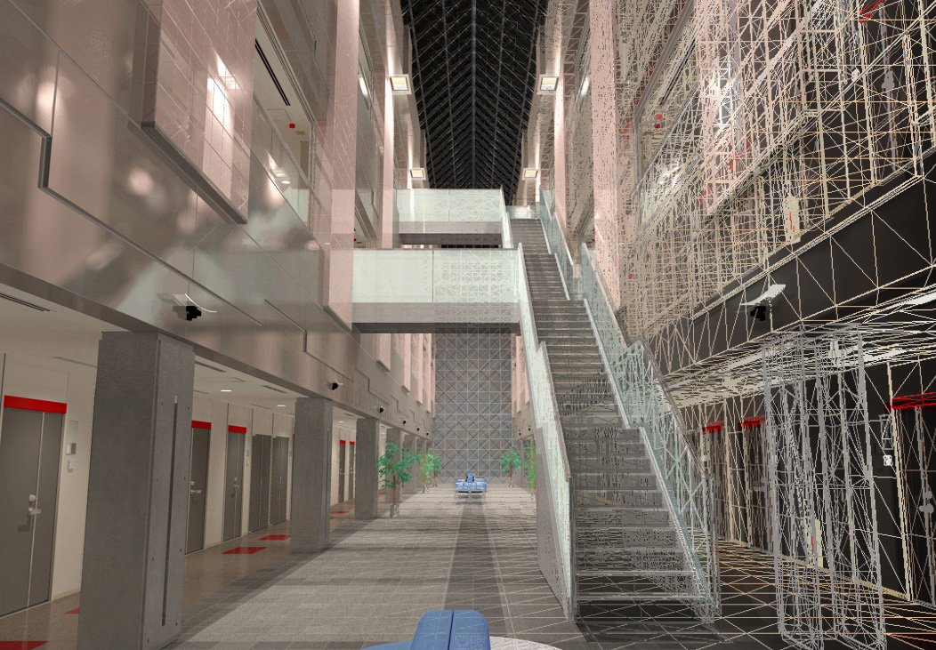
Architectural Visualization
“Atrium” created by Karol Myszkowski and Frederic Drago

Slide 6
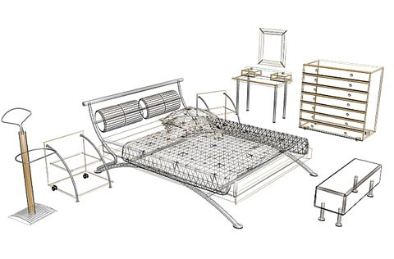
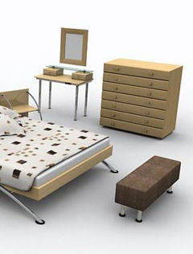
Product Catalogues
“Bedroom set-model Assisi” created by Stolid

Slide 7
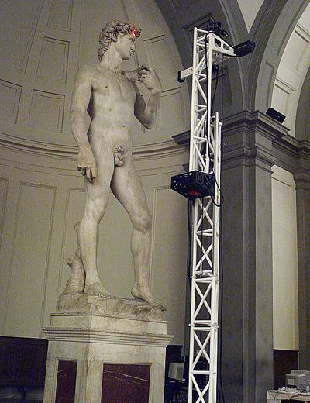
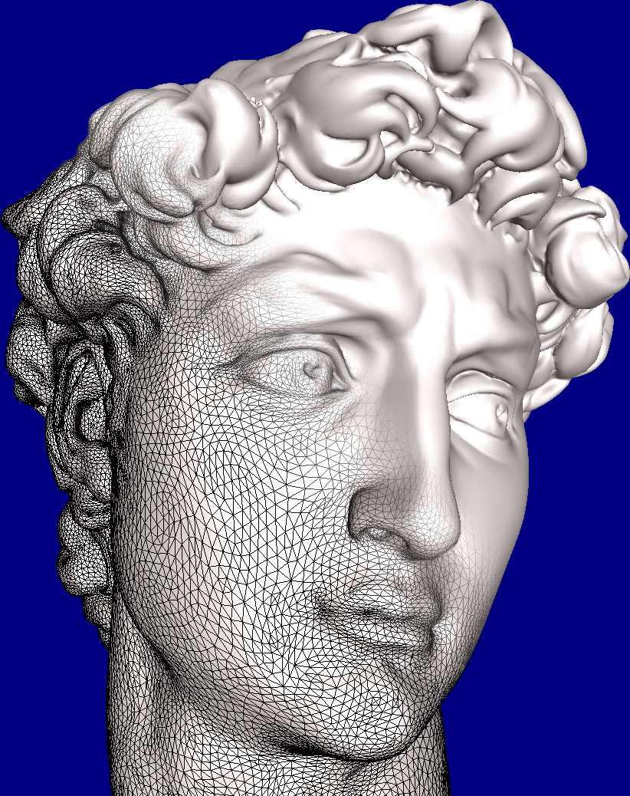
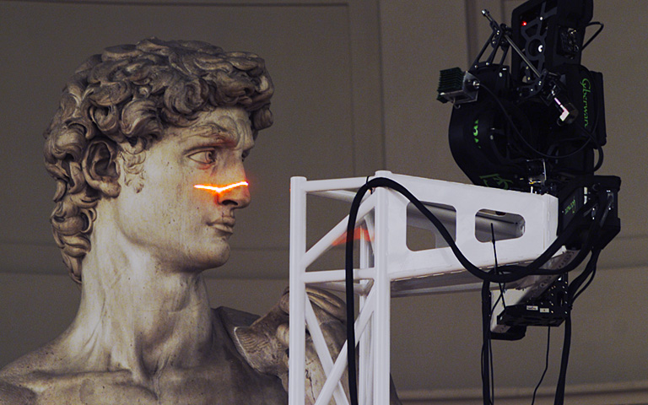
Historical Study
scanning of “Michelangelo’s David” courtesy of Marc Levoy

Slide 8
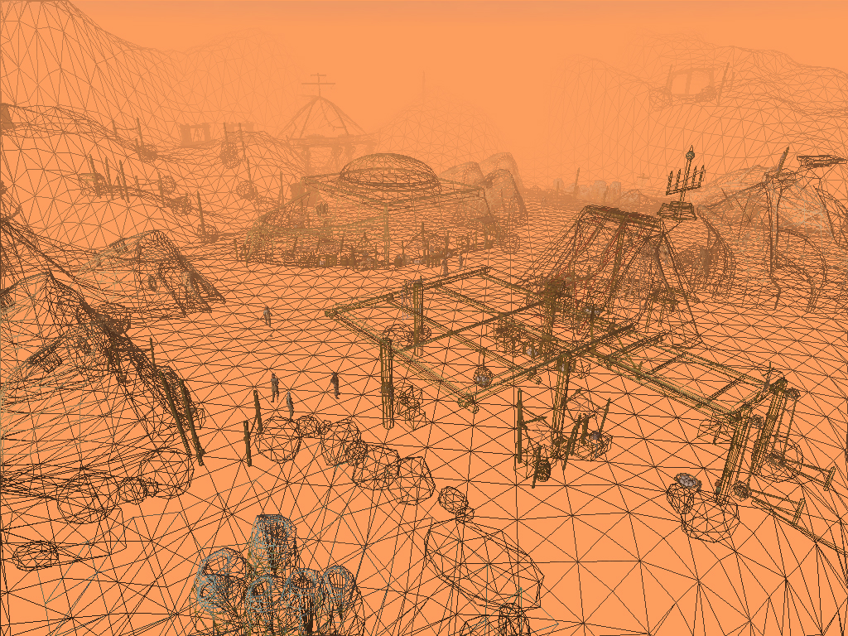
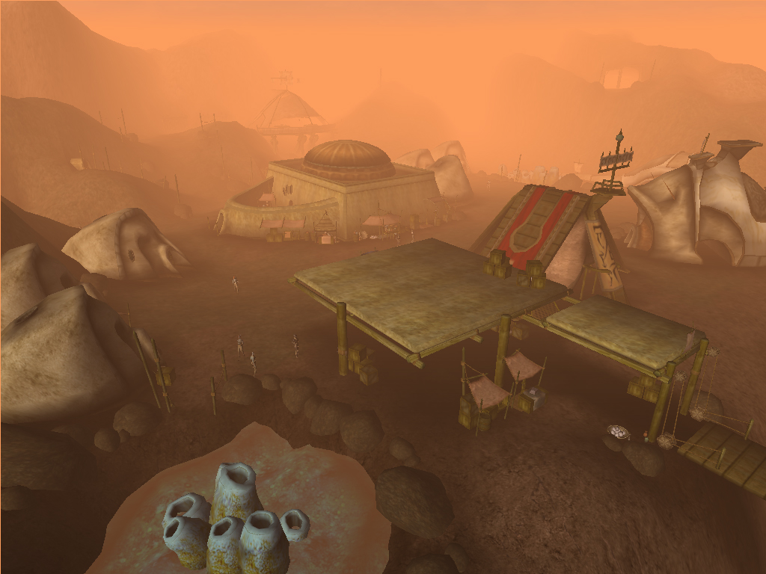
Computer Games
screenshot of “The village of Gnisis”, The Elder Scrolls III

Slide 9
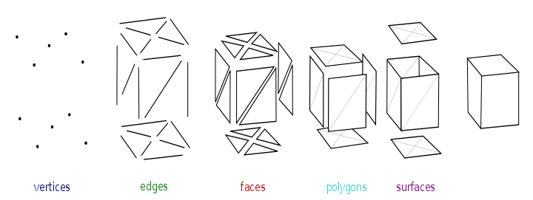
Polygonal Mesh & Mesh Basics

Slide 10
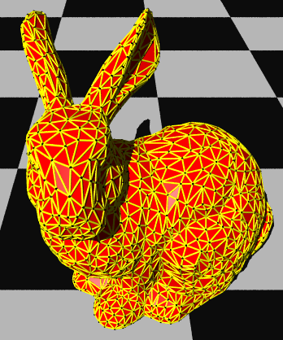
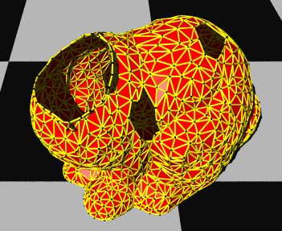
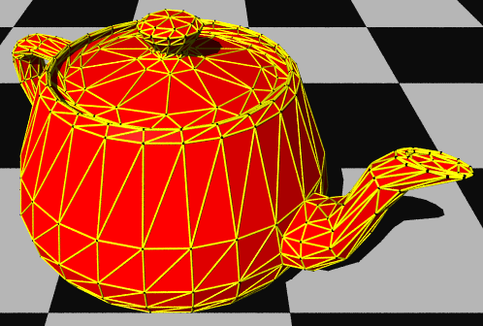
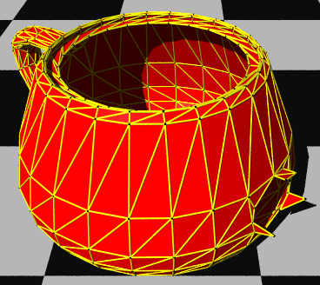
Polygonal Mesh & Mesh Basics
Mesh with Holes
Mesh with Handles
Simple Mesh
Mesh with Holes & Handles

Slide 11
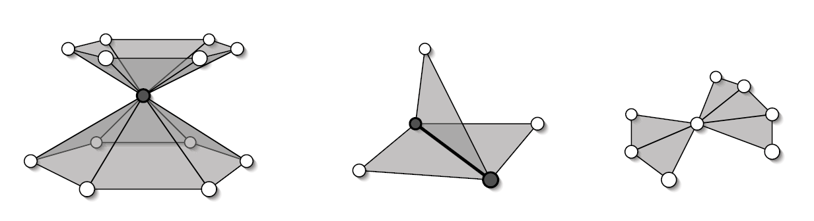
Manifold & Non-manifold Meshes
Non-manifold vertex (left) A non-manifold edge (center) has more than two incident faces (right) non-manifold but can be handled by most of the data structures

Slide 12
3D Polygonal Mesh
Isenberg

Slide 13
Standard MESH Representation
list of vertices
x₀ y₀ z₀
x₁ y₁ z₁
x₂ y₂ z₂
x₃ y₃ z₃
x₄ y₄ z₄
. . . . .
x_{n} y_{n} z_{n}
list of faces
1 4 2

Slide 14
Standard MESH Representation
list of vertices
x₀ y₀ z₀
x₁ y₁ z₁
x₂ y₂ z₂
x₃ y₃ z₃
x₄ y₄ z₄
. . . . .
x_{n} y_{n} z_{n}
list of faces
1 4 2
2 3 0
4 0 5
3 4 5
5 0 2
. . .

Slide 15
Geometry and Connectivity Information
Minimal information need to be stored is:
Where are the vertices located?
=> Mesh Geometry
How are the vertices connected?
=> Mesh Connectivity

Slide 16
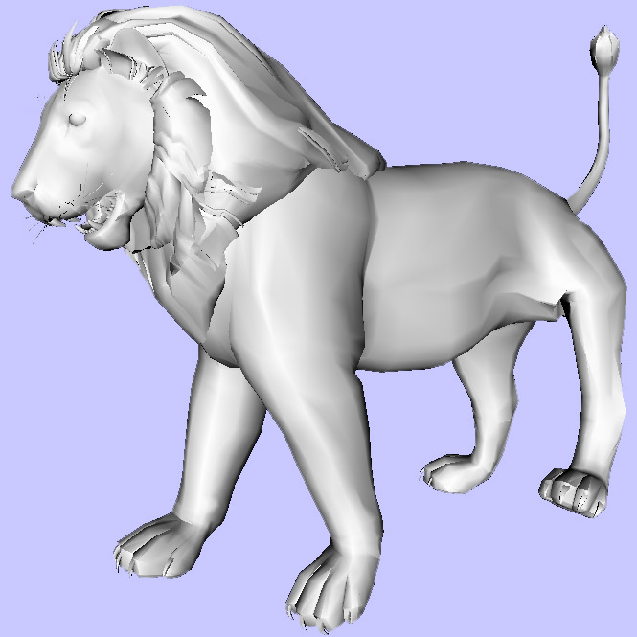
Basic Ingredients for Mesh
Connectivity face₁ 1 2 3 4 face₂ 3 4 3 face₃ 5 2 1 3 . . face_{f} 725 6291 6293
Geometry vertex₁ ( x₁ y₁ z₁ ) vertex₂ ( x₂ y₂ z₂ ) vertex₃ ( x₃ y₃ z₃ ) . . vertex_{v} ( x_{v} y_{v} z_{v} )

Slide 17
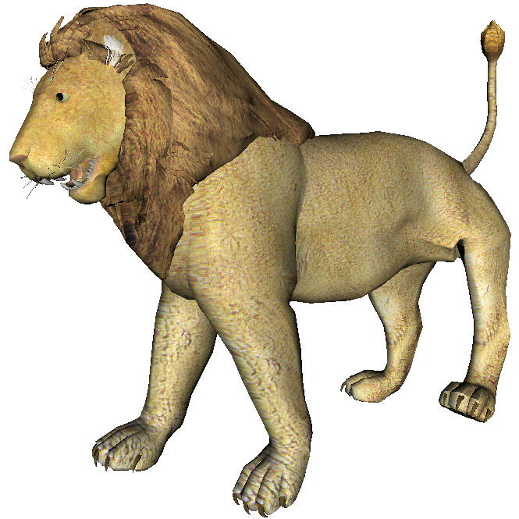
Optional Ingredients for Mesh
Mapping face₁ 1 2 3 4 face₂ 3 4 5 face₃ 5 6 1 7 . . face_{f} 9152 123 271
Values texcoord₁ (u₁ v₁) texcoord₂ (u₂ v₂) texcoord₃ (u₃ v₃) . . texcoord_{t} (u_{t} v_{t})

Slide 18
Uncompressed Connectivity info.
0 4 5 0 5
1 5 6 1 1
6 2 2 6 3
4 8 5 8 9
5 5 9 6 9
11 6 6 11 7
6 7 3 8 10
9 9 10 11 11
12 7
6 log(n) bpv
2
1
0
3
6
5
4
7
9
8
11
12
10

Slide 19
Pioneering Compression Algorithms
Geometry Compression (GC)
Geometry Compression Through Topological Surgery (TS)
Edgebreaker (EB)
Triangle Mesh Compression (TG98)
Java3D
MPEG - 4
Virtue3D

Slide 20
Other triangle based connectivity driven single-rate mesh compression algorithms
Geometry Compression, [Deering, 95]
Topological Surgery, [Taubin & Rossignac, 98]
Cut-Border Machine, [Gumhold & Strasser, 98]
Triangle Mesh Compression, [Touma & Gotsman, 98]
Edgebreaker, [Rossignac, 99]
Spectral Compression of Geometry, [Karni & Gotsman, 00]
Face Fixer, [Isenburg & Snoeyink, 00]
Valence-driven Connectivity Coding, [Alliez & Desbrun, 01]
Near-Optimal Coding, [Khodakovsky, Alliez, Desbrun &
Degree Duality Coder, [Isenburg, 02]
Polygonal Parallelogram Prediction, [Isenburg & Alliez, 02]

Slide 21
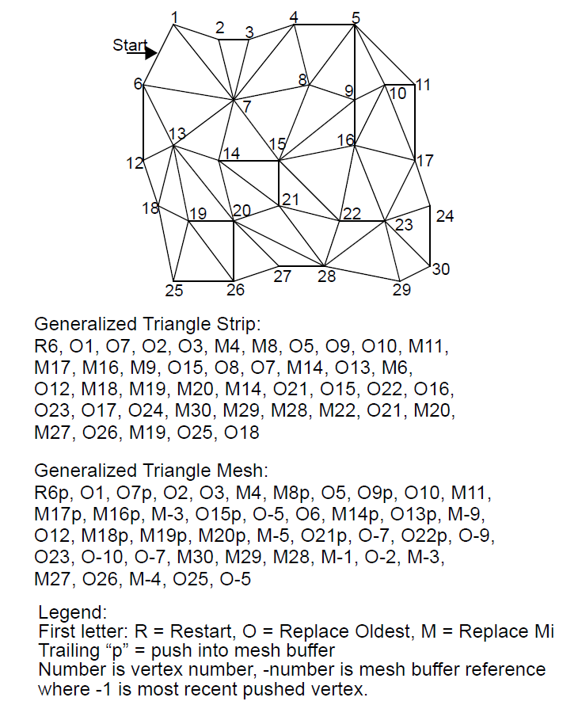
Geometry Compression Deering ‘95
Convert triangle data to generalized triangle mesh
Quantization of positions, colors, normals
Delta encoding of quantized values
Huffman tag-based variable-length encoding of deltas
Output binary output stream with Huffman table initializations and geometry compression instructions

Slide 22
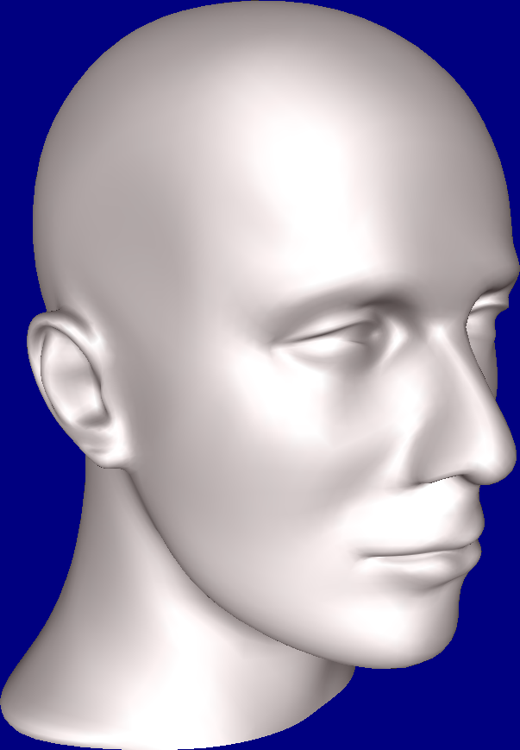
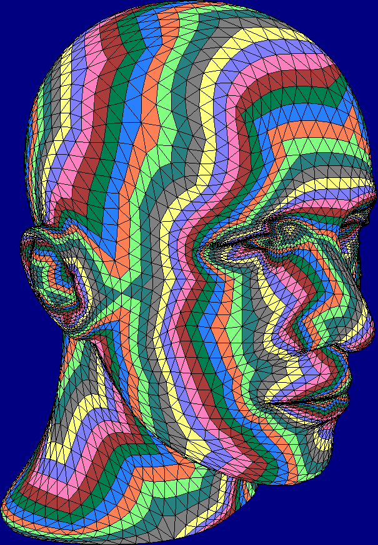
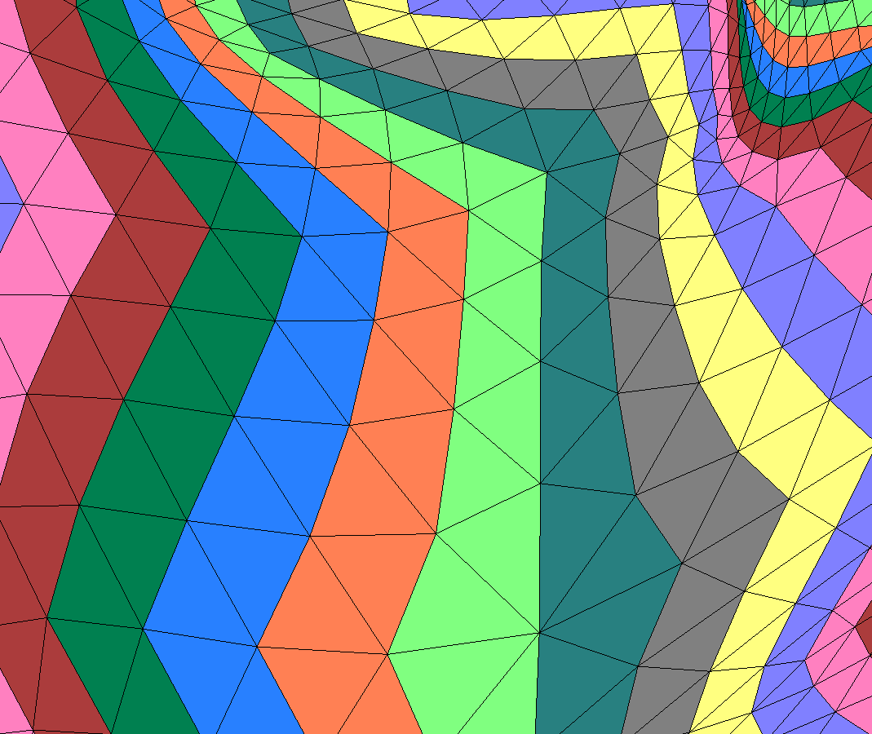
Geometry Compression Deering ‘95
Fast
Local
well suited for hw
8-11 bpv for connectivity
Geometry: highly variable
Integrated in JAVA3D
Redundancy ~ 2
One symbol per face → 2V symbols

Slide 23
Topological Surgery
The idea is to cut a given mesh along a selected set of edges to make a planar mesh. The mesh connectivity is then represented by these cuts and planar mesh.
TS encodes a triangular mesh with about 2.5 to 6 b/v
Spanning trees: a vertex and a triangle spanning tree
Connectivity encoding is lossless.
Geometry is predictively encoded.
The correction vectors are entropy encoded.
Normals, and colors are quantized.
Obtaining the optimal spanning tree is an NP-hard combinatorial problem.

Slide 24
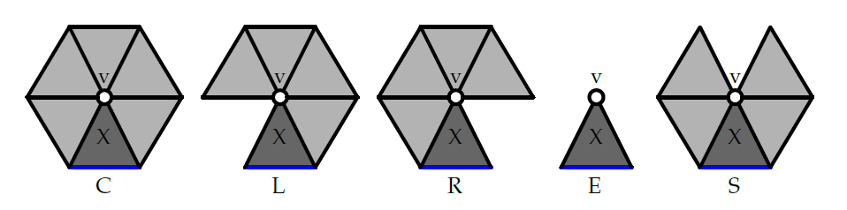
EdgeBreaker
Lossless compression for a triangle mesh, using ≈2 bits per triangle for simple meshes. Only a slight increase for meshes with holes and handles.
Destroy triangles of the mesh one-by-one, starting from the boundary and spiraling inwards
For each destruction operation, store an opcode indicating the type of the operation
Sequence of opcodes is called “history”
Length of history = number of triangles, hence linear size encoding
Compression scheme: remove X, store the operation (C, L, E, R or S), update the bounding loop and advance the gate

Slide 25
Edgebreaker in Action
5
compression
boundary
unprocessed region
processed region

Slide 26
C
5
compression
boundary
C
unprocessed region
processed region

Slide 27
C C
5
compression
boundary
C
C
unprocessed region
processed region

Slide 28
C C R
5
compression
boundary
R
C
C
unprocessed region
processed region

Slide 29
C C R C
5
compression
boundary
C
R
C
C
unprocessed region
processed region

Slide 30
C C R C R
5
compression
boundary
R
C
R
C
C
unprocessed region
processed region

Slide 31
C C R C R S
offset = 11
9
8
10
7
5
compression
boundary
11
6
1
2
S
R
3
5
C
R
4
C
C
unprocessed region
processed region

Slide 32
C C R C R S L
offset = 11
5
compression
boundary
L
S
R
C
R
C
C
unprocessed region
processed region

Slide 33
C C R C R S L C
offset = 11
5
compression
boundary
L
C
S
R
C
R
C
C
unprocessed region
processed region

Slide 34
C C R C R S L C R
offset = 11
5
compression
boundary
L
C
R
S
R
C
R
C
C
unprocessed region
processed region

Slide 35
C C R C R S L C R C
offset = 11
5
compression
boundary
L
C
R
C
S
R
C
R
C
C
unprocessed region
processed region

Slide 36
C C R C R S L C R C R
offset = 11
5
compression
boundary
L
C
R
C
S
R
R
C
R
C
C
unprocessed region
processed region

Slide 37
C C R C R S L C R C R C
offset = 11
5
compression
boundary
L
C
R
C
S
R
C
R
C
R
C
C
unprocessed region
processed region

Slide 38
C C R C R S L C R C R C R
offset = 11
5
compression
boundary
L
C
R
C
S
R
C
R
C
R
R
C
C
unprocessed region
processed region

Slide 39
C C R C R S L C R C R C R R
offset = 11
5
compression
boundary
L
C
R
C
S
R
C
R
C
R
R
R
C
C
unprocessed region
processed region

Slide 40
C C R C R S L C R C R C R R R
offset = 11
5
compression
boundary
L
C
R
C
S
R
C
R
R
C
R
R
R
C
C
unprocessed region
processed region

Slide 41
C C R C R S L C R C R C R R R L
offset = 11
5
compression
boundary
L
C
R
C
L
S
R
C
R
R
C
R
R
R
C
C
unprocessed region
processed region

Slide 42
C C R C R S L C R C R C R R R L C
offset = 11
5
compression
boundary
C
L
C
R
C
L
S
R
C
R
R
C
R
R
R
C
C
unprocessed region
processed region

Slide 43
C C R C R S L C R C R C R R R L C R
offset = 11
5
compression
boundary
R
C
L
C
R
C
L
S
R
C
R
R
C
R
R
R
C
C
unprocessed region
processed region

Slide 44
C C R C R S L C R C R C R R R L C R R
offset = 11
R
5
compression
boundary
R
C
L
C
R
C
L
S
R
C
R
R
C
R
R
R
C
C
unprocessed region
processed region

Slide 45
C C R C R S L C R C R C R R R L C R R R
offset = 11
R
R
5
compression
boundary
R
C
L
C
R
C
L
S
R
C
R
R
C
R
R
R
C
C
unprocessed region
processed region

Slide 46
offset = 3
C C R C R S L C R C R C R R R L C R R R S
offset = 11
R
R
1
S
5
compression
boundary
R
2
C
L
C
R
C
L
S
R
C
R
R
C
R
R
R
C
C
unprocessed region
processed region

Slide 47
offset = 3
C C R C R S L C R C R C R R R L C R R R S R
offset = 11
R
R
R
5
S
compression
boundary
R
C
L
C
R
C
L
S
R
C
R
R
C
R
R
R
C
C
unprocessed region
processed region

Slide 48
offset = 3
C C R C R S L C R C R C R R R L C R R R S R E
offset = 11
R
R
R
5
S
compression
boundary
E
R
C
L
C
R
C
L
S
R
C
R
R
C
R
R
R
C
C
unprocessed region
processed region

Slide 49
offset = 3
C C R C R S L C R C R C R R R L C R R R S R E E
offset = 11
R
R
R
5
S
compression
boundary
E
R
E
C
L
C
R
C
L
S
R
C
R
R
C
R
R
R
C
C
unprocessed region
processed region

Slide 50
Triangle Mesh Compression Touma & Gotsman ‘98
The idea: Deterministic edge conquering from successive pivot vertices along an active edge list
Connectivity: Output one valence symbol per vertex, + ε
Huffman encoding of valences
Features:
Average: 2 b/v for connectivity
Bit-rate vanishes to zero when regular
Not seriously challenged since ‘98

Slide 51
TG coder
slot counts
5
compression
boundary
unprocessed region
processed region

Slide 52
TG coder
7
5
compression
boundary
unprocessed region
7
processed region

Slide 53
TG coder
7 6
5
compression
boundary
zero slot
6
unprocessed region
7
processed region

Slide 54
TG coder
7 6
5
compression
boundary
6
unprocessed region
7
processed region

Slide 55
TG coder
7 6 5
5
compression
boundary
zero slot
5
6
unprocessed region
7
processed region

Slide 56
TG coder
7 6 5
5
compression
boundary
5
6
unprocessed region
7
processed region

Slide 57
TG coder
7 6 5 S
offset = 18
13
16
15
12
5
compression
boundary
18
11
S
2
4
6
5
8
7
6
unprocessed region
7
processed region

Slide 58
TG coder
7 6 5 S
offset = 18
5
compression
boundary
S
5
6
unprocessed region
7
processed region

Slide 59
TG coder
7 6 5 S 7
offset = 18
5
compression
boundary
7
S
5
6
unprocessed region
7
processed region

Slide 60
TG coder
7 6 5 S 7
offset = 18
zero slot
5
compression
boundary
7
S
5
6
unprocessed region
7
processed region

Slide 61
TG coder
7 6 5 S 7
offset = 18
5
compression
boundary
zero slot
7
S
5
6
unprocessed region
7
processed region

Slide 62
TG coder
7 6 5 S 7
offset = 18
5
compression
boundary
7
S
5
6
unprocessed region
7
processed region

Slide 63
TG coder
7 6 5 S 7 6
offset = 18
5
compression
boundary
7
S
6
5
6
unprocessed region
7
processed region

Slide 64
TG coder
7 6 5 S 7 6
offset = 18
5
compression
boundary
7
S
6
5
6
unprocessed region
7
processed region

Slide 65
TG coder
7 6 5 S 7 6 5
offset = 18
5
compression
boundary
7
S
6
5
5
6
unprocessed region
7
processed region

Slide 66
TG coder
7 6 5 S 7 6 5
offset = 18
5
compression
boundary
7
S
6
5
5
6
unprocessed region
7
processed region

Slide 67
TG coder
7 6 5 S 7 6 5
offset = 18
5
compression
boundary
7
S
6
5
5
6
unprocessed region
7
processed region

Slide 68
TG coder
7 6 5 S 7 6 5
offset = 18
5
compression
boundary
7
S
6
5
5
6
unprocessed region
7
processed region

Slide 69
TG coder
7 6 5 S 7 6 5
offset = 18
5
compression
boundary
7
S
6
5
5
6
unprocessed region
7
processed region

Slide 70
TG coder
7 6 5 S 7 6 5 6
offset = 18
5
compression
boundary
6
7
S
6
5
5
6
unprocessed region
7
processed region

Slide 71
TG coder
7 6 5 S 7 6 5 6
offset = 18
5
compression
boundary
6
7
S
6
5
5
6
unprocessed region
7
processed region

Slide 72
TG coder
7 6 5 S 7 6 5 6
offset = 18
5
compression
boundary
6
7
S
6
5
5
6
unprocessed region
7
processed region

Slide 73
TG coder
7 6 5 S 7 6 5 6
offset = 18
5
compression
boundary
6
7
S
6
5
5
6
unprocessed region
7
processed region

Slide 74
TG coder
7 6 5 S 7 6 5 6
offset = 18
5
compression
boundary
6
7
S
6
5
5
6
unprocessed region
7
processed region

Slide 75
TG coder
7 6 5 S 7 6 5 6
offset = 18
5
compression
boundary
6
7
S
6
5
5
6
unprocessed region
7
processed region

Slide 76
TG coder
7 6 5 S 7 6 5 6 7
…
E
offset = 18
5
compression
boundary
6
7
S
6
5
5
7
6
unprocessed region
7
processed region

Slide 77
Recap
Method
Note
Connectivity
(b/v)
Deering 95
Triangle strips
Redundancy ~ 2
8-11
Taubin & Rossignac 98
Spanning trees
~ 4
Touma & Gotsman 98
Valence
V symbols
~ 2 (~0 when regular)
Rossignac 99
King & Rossignac 99
Gumhold 00
Gate traversal
2V symbols, upper bound
Better upper bound
Even better upper bound
4 guaranteed
3.67 grntd.
3.55 grntd.
Alliez & Desbrun 01
Valence +
adaptive conquest
Near optimal
~1.8
[Tutte 62]

Slide 78
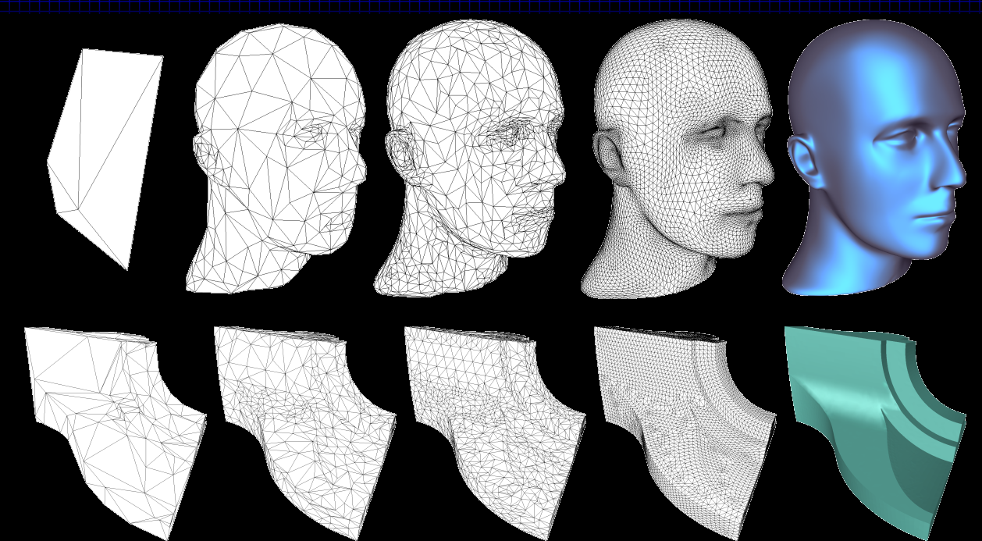
Conclusions
The valence approach guarantees:
Optimality in the regular case (6. . . .6)
*Near* optimality in the irregular case

