Slide 1
An Artificial Intelligence Based Fisheries Research On The Evaluation Of Gnathiid Parasitism In Goldblotch Grouper of ISKENDERUN BAY
ORAL, M. GENÇ, M.A. ELMAS, A.A. KAYA, D. GENÇ, E.

Slide 2
Abstract
This is a study of gnathiid isopod praniza larvae infesting goldblotch grouper (Epinephelus Costae) in the northeast Mediterranean Sea in Iskenderun Bay.
This study shows relationship between seasons, length, weight, and isopod infestation of goldblotch grouper.
We have used Self Organizing Maps to show relations between collected data that can’t be seen directly because of the high dimensionality.

Slide 3
Data
The sampling area of this study was the shoreline of Iskenderun Bay.
Fish were sampled monthly from Iskenderun Bay for a period of 12 months from May to April. A total of 331 goldblotch groupers collected.
Samples were collected using different size of spherical fish pots. Specimens were all females because the sampling was only conducted by using fish pots.
Gnathia sp. was only extracted from the epithelium of the buccal cavity and internal side of the gills arch.

Slide 4
The goldblotch grouper (Epinephelus costae)
The goldblotch grouper is a protogynous hermaphrodite, it matures as female but transforms into male after a sex reversal.
The males move slowly and live in caves and shelters and are usually caught by using harpoons.
Our samples were collected by using fish pots, resulting in collection of females only.
Male groupers are generally caught using harpoons or tridents, not fish pots.

Slide 5
Artificial Neural Network (ANN)
Artificial Neural Networks are the biologically inspired simulations performed on the computer to perform certain specific tasks like clustering, classification, pattern recognition, prediction etc.
Each input is multiplied by its corresponding weights. Weights are the information used by the neural network to solve a problem. Typically weight represents the strength of the interconnection between neurons inside the neural network.

Slide 6
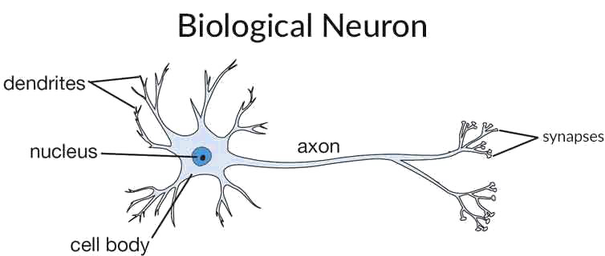
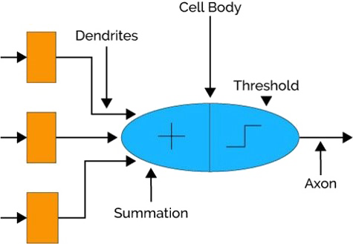
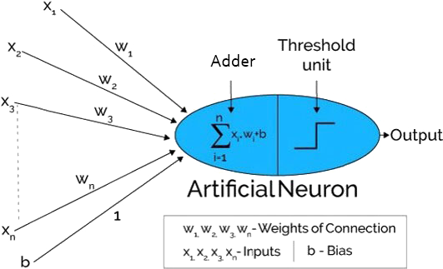
ANN Analogy

Slide 7
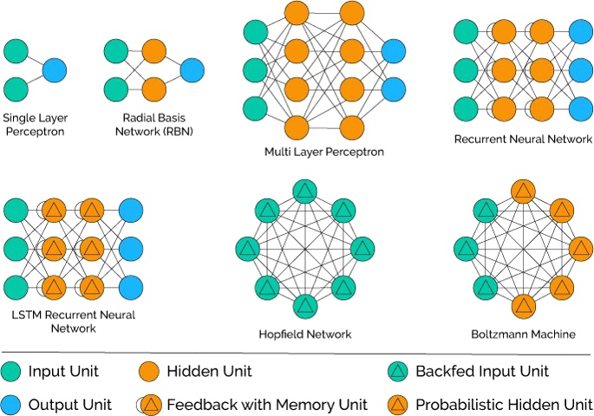
Popular Neural Network Architectures

Slide 8
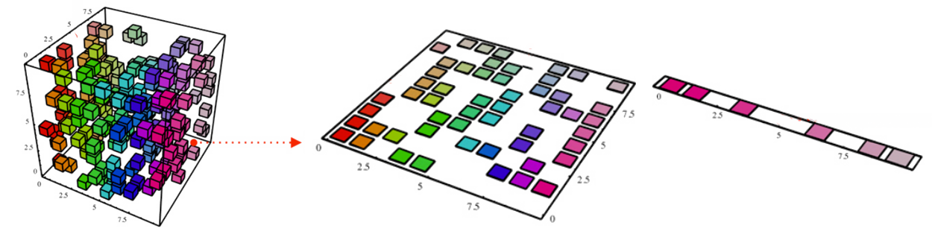
Self Organizing Maps
SOMs are neural networks that employ unsupervised learning methods, mapping their weights to conform to the given input data with a goal of representing multidimensional data in an easier and understandable form for the human eye.

Slide 9
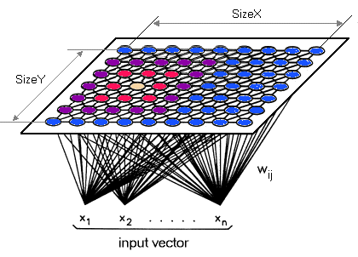
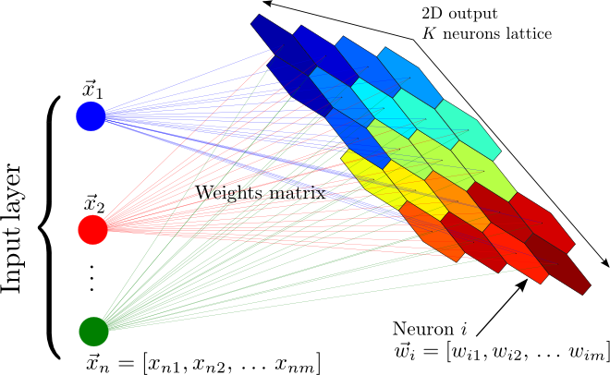
Self Organizing Maps
Provide a way of representing multidimensional data in lower dimensional spaces, usually one or two dimensions
“Self Organizing” because there is no supervision
Attempts to map weights to conform the given input data
Neurons that lie close to each other represent clusters with similar properties

Slide 10
Self Organizing Maps
There are three main ways in which a Self-Organizing Map is different from a “standard” ANN:
A SOM is not a series of layers, but typically a 2D grid of neurons
They don’t learn by error-correcting, they implement something called competitive learning
They deal with unsupervised machine learning problems
Competitive learning in the case of a SOM refers to the fact that when an input is “presented” to the network, only one of the neurons in the grid will be activated. In a way the neurons on the grid “compete” for each input.
The unsupervised aspect of a SOM refers to the idea that you present your inputs to it without associating them with an output. Instead, a SOM is used to find structure in your data.

Slide 11
SOM steps
Initialize each node’s weight vector, A, with a random real number
Take a random input vector from the training data set and feed into input layer
Every node in the network is examined to calculate which ones’ weights are most like the input vector. The winning node is commonly known as the Best Matching Unit (BMU)
Determine the neighborhood(radius) of BMU, diminishing each iteration
Reward the nodes by adjusting weight vector, A, of each node within the neighborhood determined in step 4
Return to step 2 and repeat the procedure n times

Slide 12
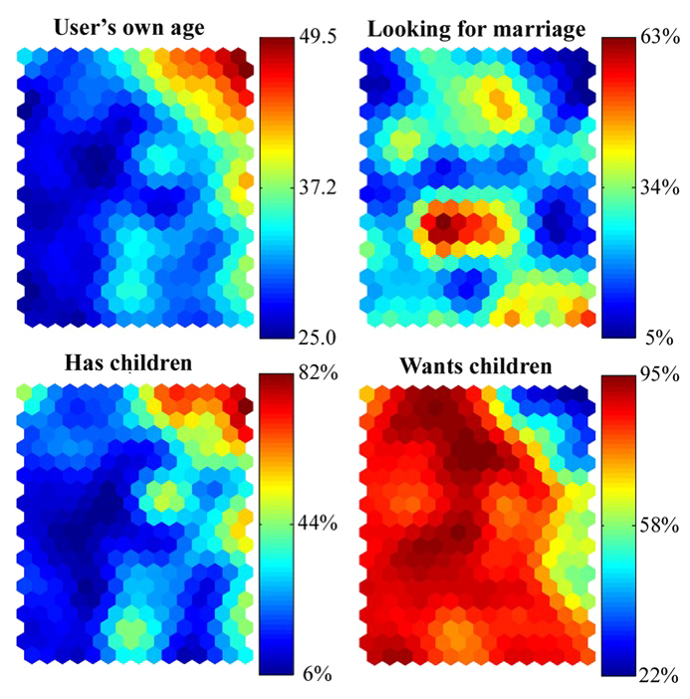
SOM example

Slide 13
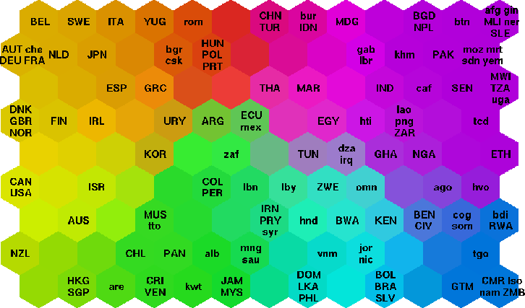
SOM example continue
Countries organized on a self-organizing map based on indicators related to poverty.

Slide 14
SOM example continue
Test chemicals from the Tox21 library were arranged in 651 clusters based on structural similarity. Compared with the library overall, “enriched” clusters showed above-average evidence of harming mitochondria, reflected as a decrease in MMP. Identifying structural features associated with decreased MMP allows researchers to choose appropriate candidate chemicals for further research.

Slide 15
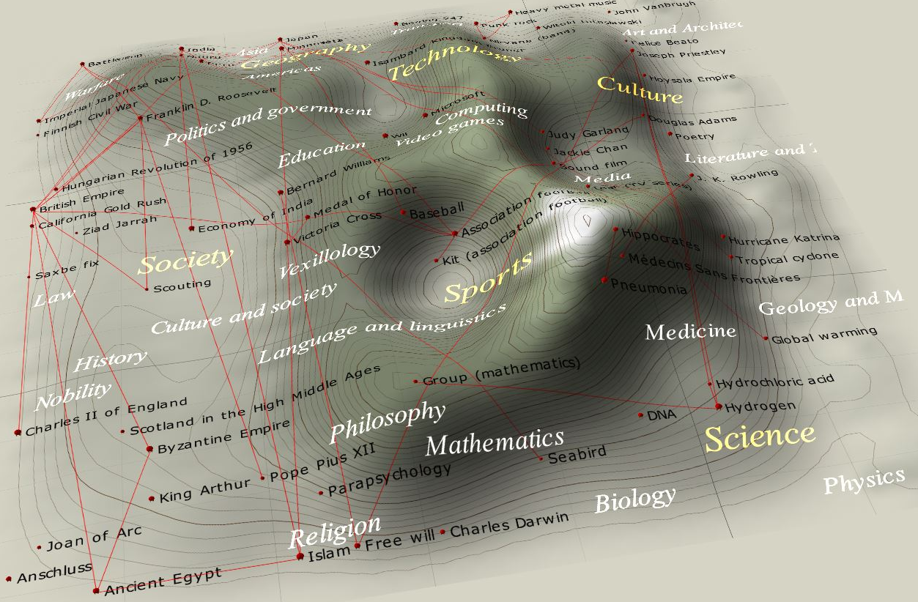
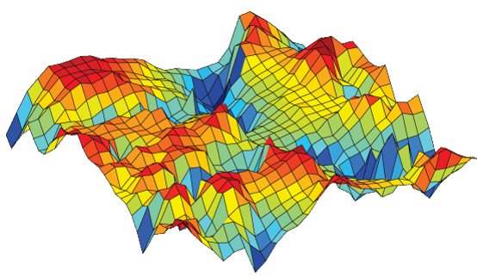
SOM visualization methods

Slide 16
The cell G5 in all maps, for example, represents “Parasitized” (map II) samples caught in the “Warm” season (map I), which were short in length (map III) and low weight (map IV). The number of parasites per fish (map V) was about 20.

Slide 17
Conclusion
Although the gnathiid parasite high intensities were observed in fish, there was no significant effect on the growth and general health condition of infested fish.

Slide 18
References
https://www.intechopen.com/books/hemodialysis/implementation-and-management-of-strategies-to-set-and-to-achieve-clinical-targets
https://hackernoon.com/overview-of-artificial-neural-networks-and-its-applications-2525c1addff7
https://en.wikipedia.org/wiki/File:Self_oraganizing_map_cartography.jpg
http://www.turingfinance.com/artificial-intelligence-and-statistics-principal-component-analysis-and-self-organizing-maps/
Potential Mitochondrial Toxicants - Environmental Health Perspectives - https://www.ncbi.nlm.nih.gov/pmc/articles/PMC4286266/
World Poverty Map - http://www.cis.hut.fi/research/som-research/worldmap.html
Self-Organising Map Approach to Individual Profiles: Age, Sex and Culture in Internet Dating - http://www.socresonline.org.uk/11/1/suna.html
SOMz: Self Organizing Maps and random atlas - http://matias-ck.com/mlz/somz.html

